Slide 1
EduGuide PH: An AI-Powered Study and Career Guidance System Amigo School of Calinan, Inc.
Researchers:
Garri Clyde Nakano
Elijah Drex Estorco
Mark Tristan Fronteras

Slide 2
PRESENTATION ROADMAP
Part I: Analysis
Organization Background
Business Environment
Current System Overview
Problem Statement (PIECES)
Critical Success Factors
Objectives
Feasible Alternatives
Feasibility Analysis
Part II: Design
Proposed Solution
Functional Requirements
Use Case Diagram
Proposed System Architecture
Database Design
Technology Stack
User Interface Design

Slide 3
PRESENTATION ROADMAP
Part III: Development
System Development
Development Methodology
Modules Developed
Key Features Demo
Part IV: Testing & Results
Testing Methodology
Test Cases
User Acceptance Testing
UAT Results
Findings
Conclusions
Recommendations
Project Contributions

Slide 4
ORGANIZATION BACKGROUND
Business Profile:
Name: Amigo School of Calinan, Inc. (ASCI)
Location: Dr. de Lara Street, Calinan, Davao City
Type: Private Educational Institution
Levels Offered: Kindergarten through Grade 12 (K-12)
Status: Registered business entity
Workforce: 20-30 teaching and non-teaching personnel
Student Population: Kindergarten to Grade 12

Slide 5
ORGANIZATION BACKGROUND
Vision: ASCI dreams of its students who passionately love their country and whose values and competencies enable them to realize their full potential and contribute meaningfully to building the nation.
Mission: ASCI protects and promotes the right of every student to quality, equitable, culture-based, and complete basic education where students learn in a child-friendly, gender-sensitive, safe, and motivating environment.

Slide 6
ORGANIZATION BACKGROUND
Products/Services:
Basic Education (K-12)
Traditional classroom instruction
Manual guidance counseling services
Limited ICT integration
Target Users:
Students (Kindergarten to Grade 12)
Teachers (20-30 faculty members)
Guidance Counselors
School Administrators

Slide 7
BUSINESS ENVIRONMENT
Industry Overview: The Philippine educational sector is increasingly integrating Information and Communication Technology (ICT) to enhance learning, driven by both government initiatives (e.g., DepEd Commons) and rising parent/student expectations.
Current Challenges:
Limited Access to Tutors: Many students cannot afford private tutoring, creating a gap in personalized academic help.
Career Guidance Needs: Students lack access to tools for exploring career paths aligned with their interests and strengths.
Faculty & Counselor Workload: Limited staff makes it difficult to provide individualized support to all students.
Existing ICT Infrastructure:
Basic ICT resources (desktop PCs, computer lab with limited internet).
Guidance office uses spreadsheets for manual record-keeping.
No centralized digital system for academic support, tutoring, or career guidance.

Slide 8
CURRENT SYSTEM OVERVIEW
Current Workflow:
Academic Support: Students ask questions during or after class. If the teacher is unavailable, they consult peers or textbooks. There is no after-hours support.
Career Guidance: Students schedule appointments with the Guidance Associate. They fill out paper-based interest inventories, and the counselor provides manual suggestions.
Existing Documents: Printed modules, textbooks, paper-based interest inventories, and manually kept student records.
Current Pain Points:
Slow response times for student queries.
Lack of after-hours academic support.
Time-consuming, manual career counseling process.
No centralized database to track common student difficulties.
High reliance on manual paperwork.

Slide 9
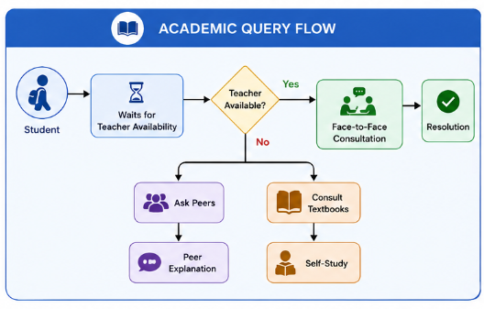
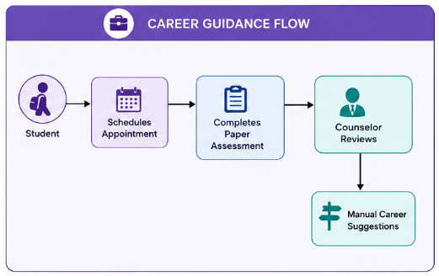
CURRENT SYSTEM DIAGRAM
Academic Query Flow
Career Guidance Flow

Slide 10
PROBLEM STATEMENT (PIECES)
Category | Problem / Issue | Cause | Opportunity / Solution Direction
Performance | Slow response to student queries | Teacher availability limited to class hours | AI chatbot provides instant 24/7 responses
Information | No record of common student difficulties | No centralized query logging | System tracks questions and generates reports for teachers
Economics | High cost of private tutoring | Lack of affordable alternatives | Free AI-powered assistance reduces need for paid tutors
Control | No monitoring of student learning progress | Manual tracking only | Dashboard for teachers to view student activity
Efficiency | Counselor time spent on repetitive career advice | Manual assessments and consultations | Automated career suggestion engine reduces counselor workload
Service | Students lack after-hours support | No system available outside school hours | Web-based platform accessible anytime from mobile devices

Slide 11
CRITICAL SUCCESS FACTORS
Personalized Academic Support: Students receive help with difficult lessons outside class hours.
Accessible Learning Resources: Study materials are available anytime, even on mobile devices.
Career Guidance Availability: Students can explore career options based on their interests.
Inclusive Language Support: Students can interact in Filipino, Cebuano, or English.
Performance Tracking: Monitoring student queries enables data-driven interventions.

Slide 12
OBJECTIVES
General Objective: To develop and implement an AI-powered study and career advice system (EduGuide PH) that improves academic support, learning outcomes, and career advising for students at Amigo School of Calinan.
Specific Objectives:
To provide students with immediate, 24/7 access to academic explanations via an AI chatbot.
To provide tailored career route recommendations based on student interests and strengths.
To promote inclusive education through multilingual interactions (English, Tagalog, Cebuano).
To offer mobile accessibility for students using smartphones, even with low internet connectivity.
To set up a secure and privacy-compliant system for managing student data

Slide 13
FEASIBLE ALTERNATIVES
Alternative | Advantages | Disadvantages | Estimated Cost | Timeline
Alt 1 – Continue Manual System | No cost; familiar process | Limited support; no after-hours help; high counselor workload | 0 | N/A
Alt 2 – Basic Website with FAQs | Low cost; accessible | No interactivity; no personalization; no AI | ₱5,000 – ₱10,000 | 1–2 months
Alt 3 – EduGuide PH AI System | 24/7 AI support; multilingual; career guidance; scalable | Higher initial cost; requires training and internet | ₱30,000 – ₱60,000 | 3–4 months

Slide 14
FEASIBILITY ANALYSIS
Feasibility Dimension | Weight | Alt 1 – Manual | Alt 2 – Basic Website | Alt 3 – EduGuide PH
Technical (20%) | 0.2 | 3 (0.60) | 4 (0.80) | 4 (0.80)
Economic (25%) | 0.25 | 5 (1.25) | 4 (1.00) | 3 (0.75)
Operational (20%) | 0.2 | 4 (0.80) | 4 (0.80) | 4 (0.80)
Schedule (20%) | 0.2 | 5 (1.00) | 4 (0.80) | 3 (0.60)
Legal/Security (15%) | 0.15 | 2 (0.30) | 3 (0.45) | 5 (0.75)
Total Weighted Score | 1 | 3.95 | 3.85 | 3.7

Slide 15
FEASIBILITY ANALYSIS
Ranking and Recommendations:
Rank 1: Continue Manual System (short-term only)
Rank 2: Basic Website with FAQs
Rank 3: EduGuide PH AI System – Recommended for long-term strategic value
Conclusion: While the manual method has the best short-term viability, EduGuide PH is recommended because it solves the core issues of poor academic support, lack of career advising, and student involvement. Its AI capabilities, multilingual assistance, and mobile accessibility make it the best solution for Amigo School of Calinan.

Slide 16
PROPOSED SOLUTION
System Name: EduGuide PH
Overview: A web-based AI study and career coach that enables students to receive individualized learning support. The system features an AI chatbot that can respond to academic questions, explain lessons, and recommend career paths based on user input
Value Proposition:
24/7 personalized academic support.
Multilingual support (English, Tagalog, Cebuano).
Mobile-friendly for students in areas with limited internet.
Automated career guidance to supplement counselor efforts.

Slide 17
FUNCTIONAL REQUIREMENTS
ID | Requirement | User Role | Input | Output | Validation Rules
FR-01 | User Login and Access Control | Student, Teacher, Admin | Username, Password | Authenticated session; role-based dashboard | Credentials must match database
FR-02 | AI Chatbot for Academic Questions | Student | Text question (English, Tagalog, Cebuano) | AI-generated explanation | Question must be non-empty
FR-03 | Career Path Suggestions | Student | Interests, grade level, strengths | List of suggested careers with descriptions | Input must be valid
FR-04 | Suggested Prompts | Student | None | List of common academic topics | Display predefined list
FR-05 | Voice Input | Student | Audio recording | Converted text query | Microphone permission required
FR-06 | File Attachment | Student | Image or document | AI-assisted response based on attachment | File size ≤ 5MB
FR-07 | Multilingual Support | Student | Language selection | Responses in chosen language | Supports English, Tagalog, Cebuano

Slide 18
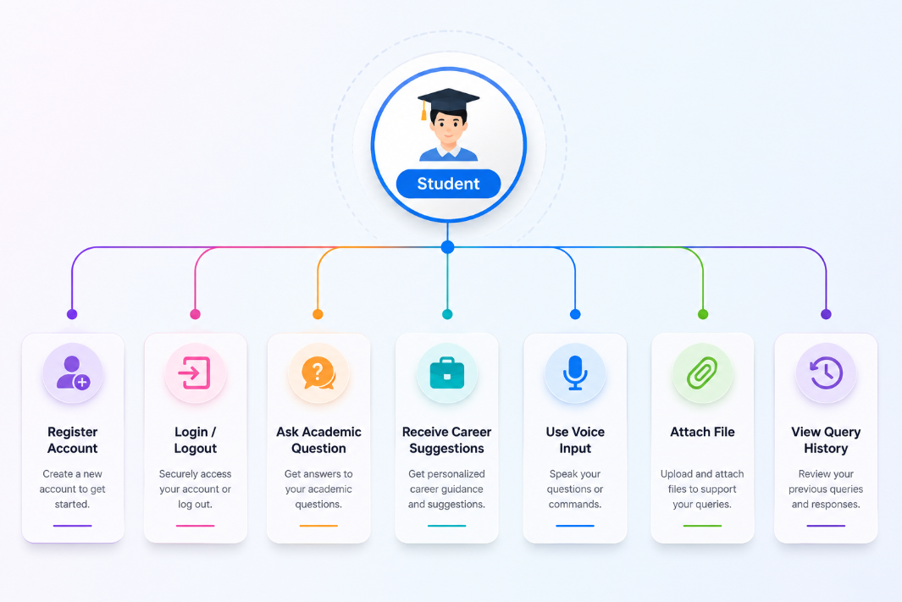
USE CASE DIAGRAM

Slide 19
Proposed System Architecture
Context Diagram:
External Entities: Student
Process: EduGuide PH System
Data Flows: Student inputs (questions, career interests, file attachments) -> System; Outputs (AI responses, career suggestions) -> Student
Data Flow Diagram (DFD Level 1):
Student interacts with the User Interface.
The Authentication Module validates credentials.
The AI Processing Module communicates with the Google Gemini API to generate responses.
The Career Guidance Module processes student inputs to suggest careers.
The Database (Supabase PostgreSQL) stores user profiles, query history, and career preferences.
Entity Relationship Diagram (ERD):
Entities: students, queries, career_preferences, sessions
Relationships:
One student can have many queries.
One student can have one career_preference.

Slide 20
Database Design
Entities:
students (student_id, full_name, grade_level, email, password_hash, created_at)
queries (query_id, student_id, question, language, response, timestamp)
career_preferences (preference_id, student_id, interests, strengths, suggested_careers, saved_at)
sessions (session_id, student_id, token, created_at, expires_at)
Data Dictionary Summary:
students.student_id: UUID (Primary Key)
students.email: VARCHAR, Unique
queries.question: TEXT, Non-empty
queries.language: ENUM ('English', 'Tagalog', 'Cebuano')
career_preferences.interests: TEXT Array

Slide 21
Technology Stack
Category | Technology Used | Purpose
Frontend | React | Dynamic, responsive, and user-friendly web interface
Backend | Node.js | Server-side logic and API development
Database | Supabase PostgreSQL | Store user accounts, queries, logs, and career info
Authentication | Supabase Authentication | Secure user registration and login
AI Integration | Google Gemini API | Core AI capabilities for chatbot, quizzes, and careers
Hosting | Vercel | Web application deployment and hosting
IDE / Code Editor | VS Code / Cursor | Code development, debugging, and management
Version Control | Git & GitHub | Source code tracking, collaboration, and version management

Slide 22
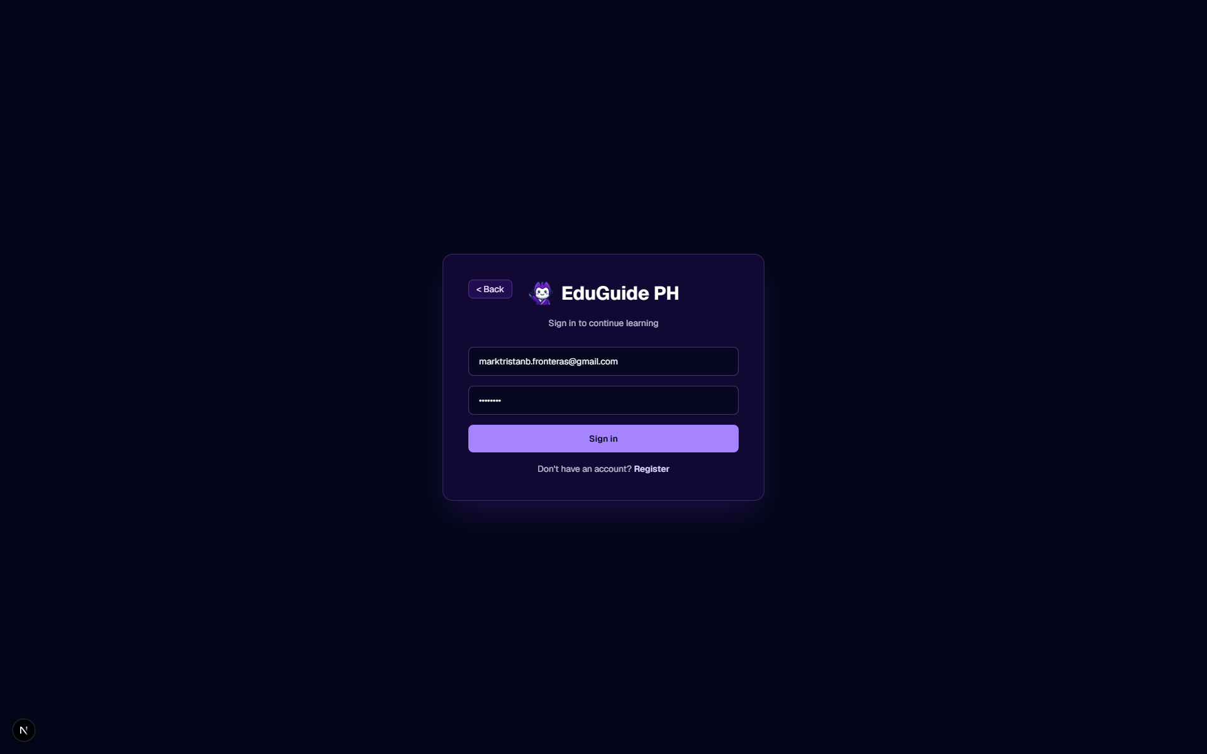
User Interface Design (Wireframes / Mockups)
Login Screen: Simple, clean interface for username and password.

Slide 23
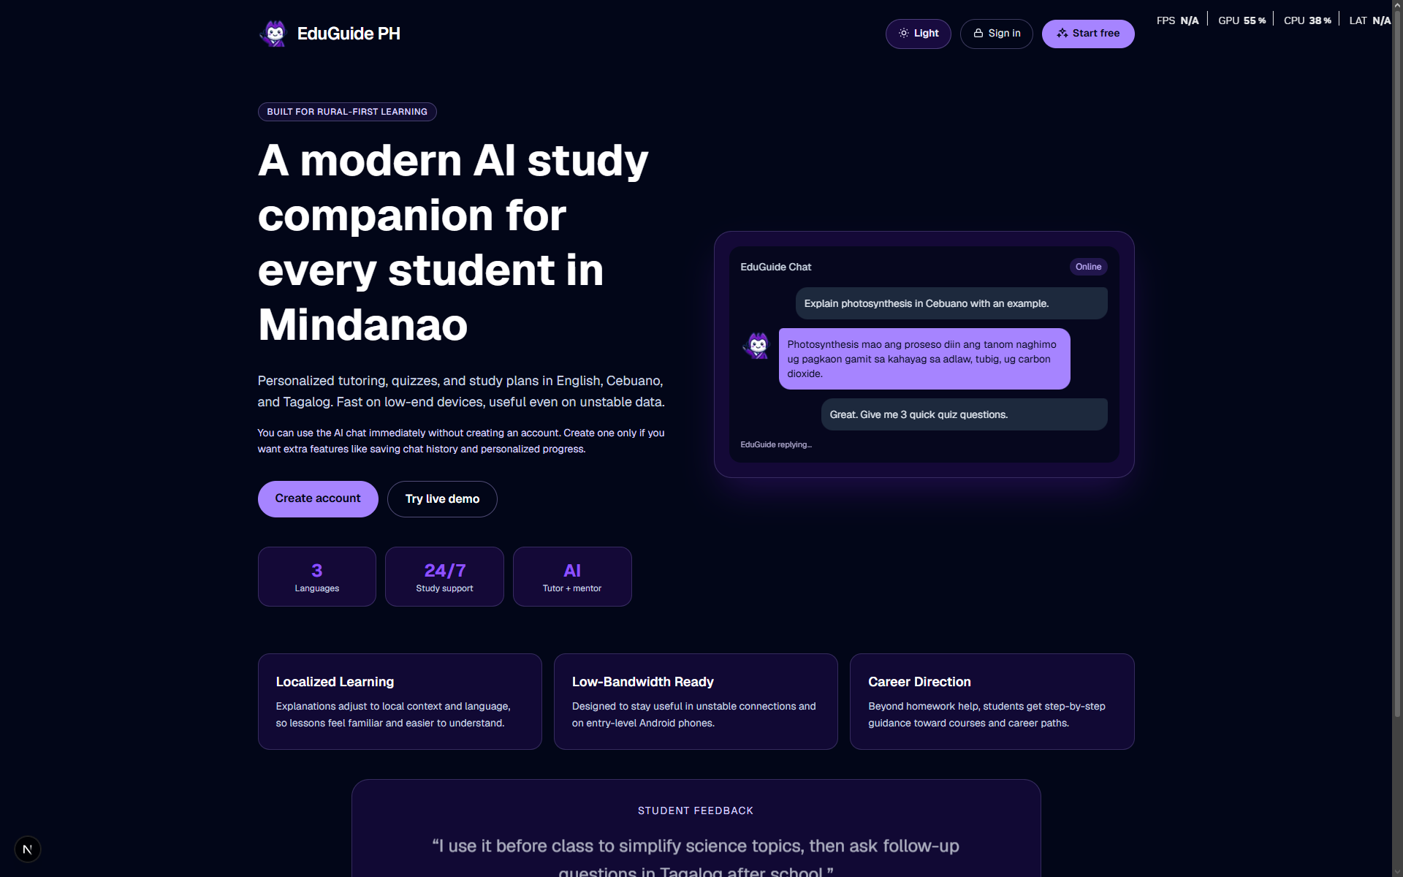
User Interface Design (Wireframes / Mockups)
Dashboard: Features a central chat window, voice input icon, attachment button, and suggested prompts.

Slide 24
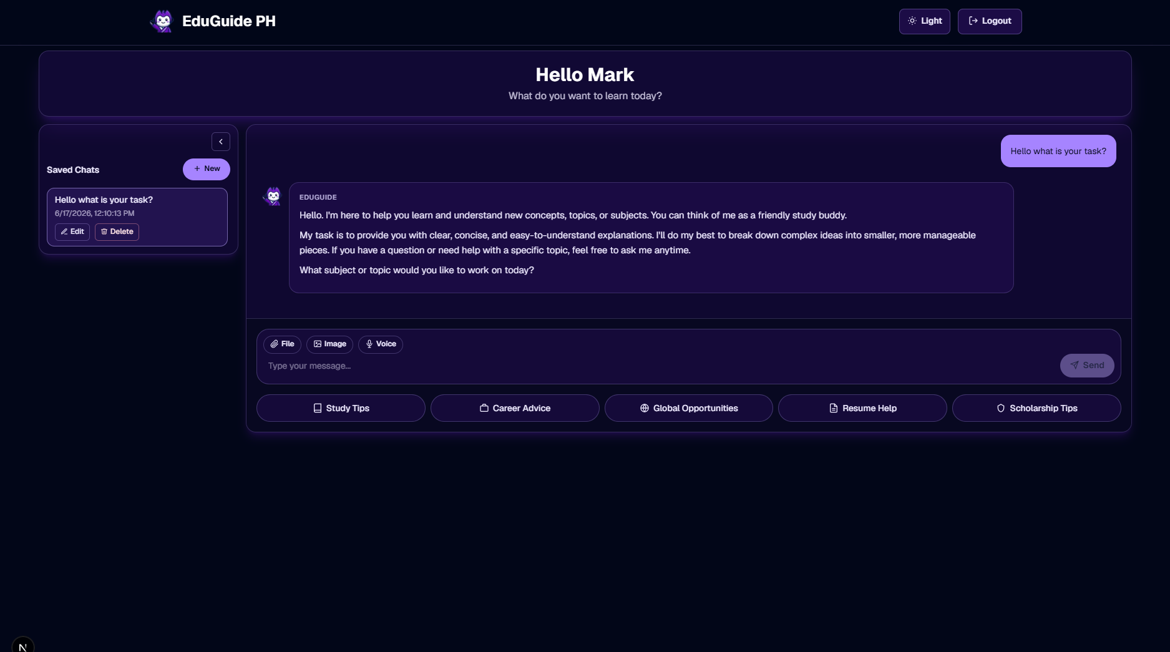
User Interface Design (Wireframes / Mockups)
Career Guidance Module: Input fields for interests, grade level, and strengths. Output displays a list of suggested careers.

Slide 25
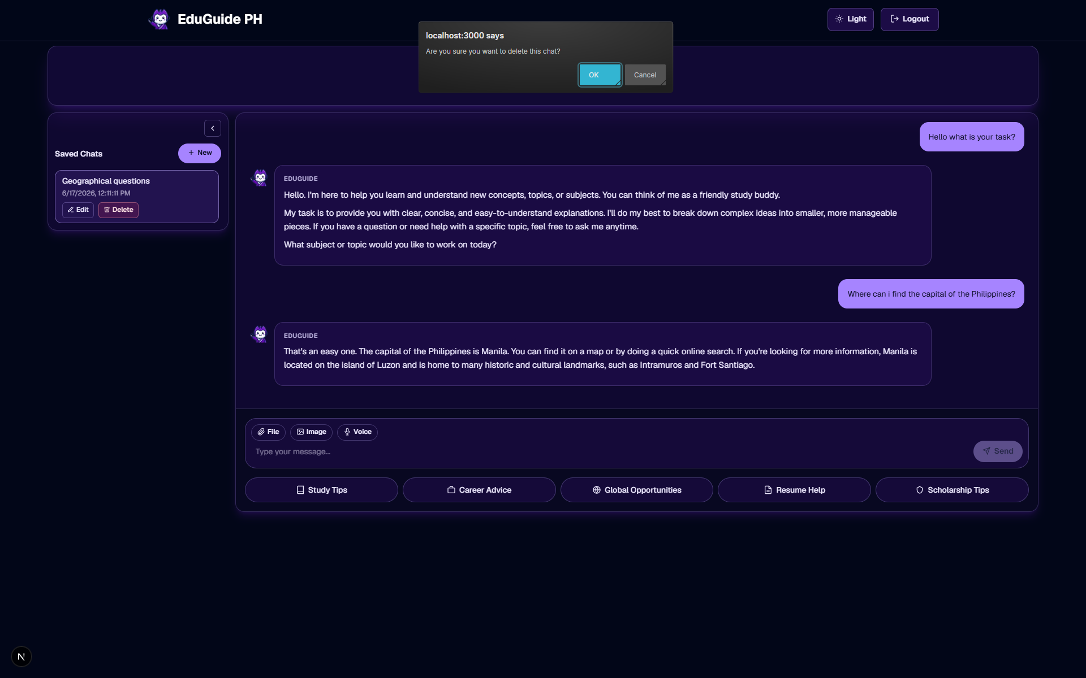
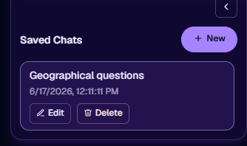
User Interface Design (Wireframes / Mockups)
Query History: A list of previous questions and AI responses for student reference.

Slide 26
System Development
Development Methodology: Agile Scrum Methodology
Emphasizes iterative development, collaboration, continuous feedback, and incremental delivery.
Modules Developed:
User Authentication Module
AI Chatbot Module (using Google Gemini API)
Career Guidance Module
Multilingual Support Module (English, Tagalog, Cebuano)
Voice Input Module
File Attachment Module

Slide 27
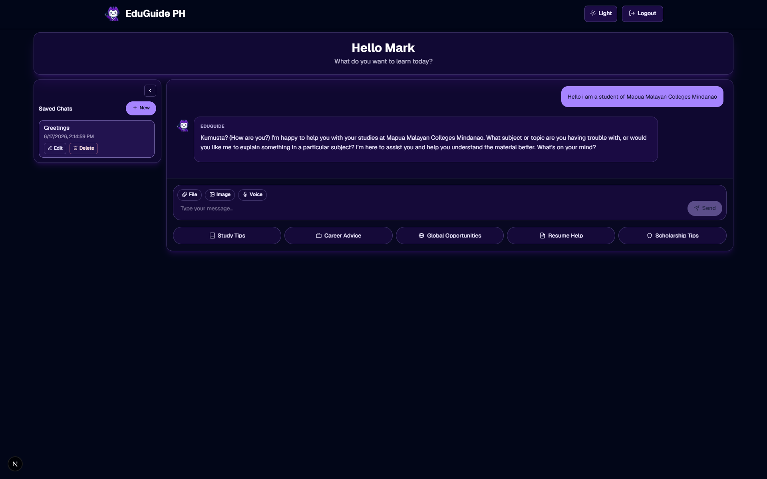
Key Features Demo
Student Dashboard with the AI Chatbot interface.

Slide 28
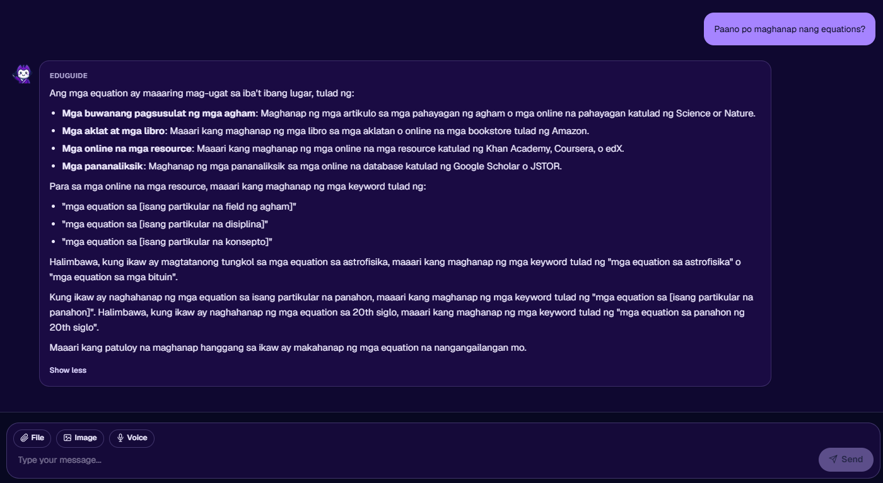
Key Features Demo
A conversation thread showing a response in Tagalog

Slide 29
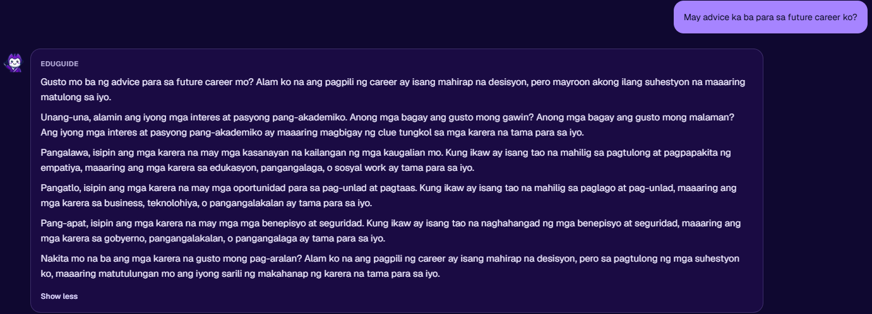
Key Features Demo
The Career Suggestions input and output screen.

Slide 30
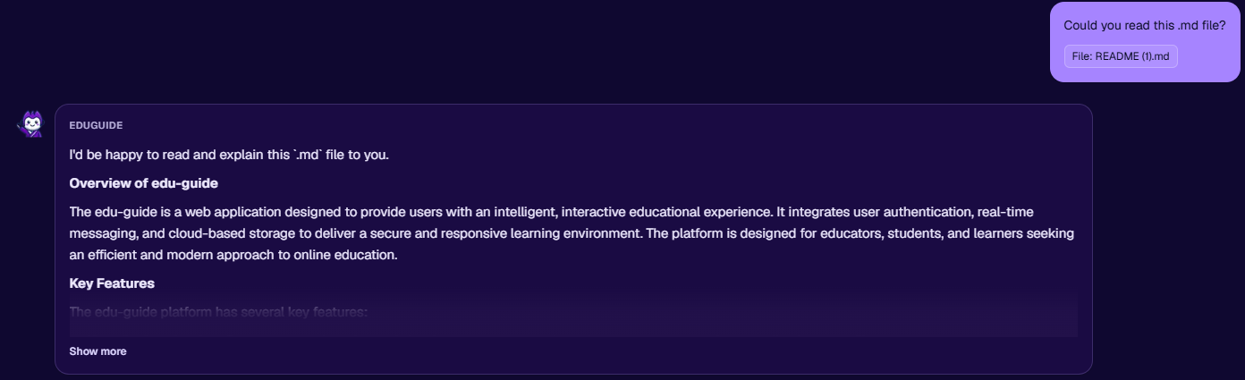
Key Features Demo
The voice input and file attachment features in action.

Slide 31
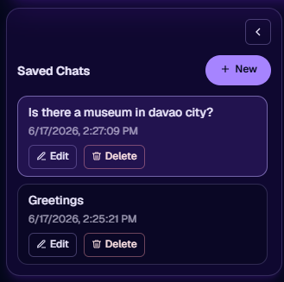
Key Features Demo
The Query History page.

Slide 32
Testing Methodology
Testing Procedures:
Unit Testing: Individual components and functions were tested for correctness.
Integration Testing: The interaction between the frontend, backend, AI API, and database was verified.
User Acceptance Testing (UAT): Student users performed defined tasks to validate real-world usability.
Testing Environment:
Browsers: Google Chrome and Microsoft Edge.
Devices: Laptops and smartphones.
Network: Broadband internet connection.

Slide 33
Test Cases
Test Case # | Tested By | Tested Date | Expected Outcome | Actual Outcome | Remarks
1a | John Mark Valencia | June 3, 2026 | Be able to register a new account. | User successfully registered a new account with valid details. | Passed
1b | Sophia Mendoza | June 3, 2026 | Be able to log in using registered credentials. | User successfully authenticated and was redirected to the main dashboard. | Passed
1c | Christian Jay Duterte | June 3, 2026 | Be able to log out of the application. | User successfully logged out and was returned to the login screen. | Passed
1d | John Mark Valencia | June 3, 2026 | Maintain active user session until logout. | User session remained active for the duration of the testing period until manual logout. | Passed
2a | Sophia Mendoza | June 3, 2026 | Ask a question in English and receive an accurate AI-generated explanation. | The AI generated a relevant and accurate explanation in English. | Passed
2b | Christian Jay Duterte | June 3, 2026 | Ask a question in Tagalog and receive an accurate AI-generated explanation. | The AI generated a relevant and accurate explanation in Tagalog. | Passed
2c | John Mark Valencia | June 3, 2026 | Ask a question in Cebuano and receive an accurate AI-generated explanation. | The AI generated a relevant and accurate explanation in Cebuano. | Passed
2d | Sophia Mendoza | June 3, 2026 | Ask a question and receive a response. | System processed the question and provided a coherent, non-empty response. | Passed
3a | Christian Jay Duterte | June 4, 2026 | Input interests, grade level, and strengths. | The system successfully accepted the input parameters. | Passed
3b | John Mark Valencia | June 4, 2026 | Receive a list of suggested careers with descriptions. | The system generated a list of relevant careers with accurate descriptions. | Passed

Slide 34
Test Cases
4a | Sophia Mendoza | June 4, 2026 | View a list of predefined common academic topics. | Predefined prompts were displayed correctly on the interface. | Passed
4b | Christian Jay Duterte | June 4, 2026 | Click a prompt and receive an AI-generated response. | The system processed the prompt and generated a relevant explanation. | Passed
5a | John Mark Valencia | June 4, 2026 | Use voice input to ask a question. | The system successfully activated the microphone and recorded audio. | Passed
5b | Sophia Mendoza | June 4, 2026 | Verify that audio is converted to text correctly. | The audio was transcribed to text with acceptable accuracy. | Passed
6a | Christian Jay Duterte | June 5, 2026 | Attach an image file (≤5MB) with a query. | The system accepted the image file. | Passed
6b | John Mark Valencia | June 5, 2026 | Attach a document file (≤5MB) with a query. | The system accepted the document file. | Passed
6c | Sophia Mendoza | June 5, 2026 | Receive an AI-assisted response based on the attachment. | The AI processed the attachment and generated a context-aware response. | Passed
7a | Christian Jay Duterte | June 5, 2026 | View student profile. | The student's profile information was displayed correctly. | Passed
7b | John Mark Valencia | June 5, 2026 | Update student profile information. | The student successfully updated their profile, and changes were saved. | Passed
7c | Sophia Mendoza | June 5, 2026 | View personal query history. | The student's previous queries were displayed correctly. | Passed

Slide 35
User Acceptance Testing (UAT
Respondents: Student users from Amigo School of Calinan.
Evaluation Instrument: UAT was conducted using a structured test script where students performed specific tasks. Results were recorded in a UAT matrix.
Procedure:
Students were briefed on the system's purpose and features.
Each student was given a list of test cases to perform.
The team observed and recorded the actual outcomes against the expected outcomes.
Results were documented and validated with user signatures.

Slide 36
UAT Results
Test Case # | Tested By | Tested Date | Remarks
1a | John Mark Valencia | June 3, 2026 | Passed
1b | Sophia Mendoza | June 3, 2026 | Passed
1c | Christian Jay Duterte | June 3, 2026 | Passed
1d | John Mark Valencia | June 3, 2026 | Passed
2a | Sophia Mendoza | June 3, 2026 | Passed
2b | Christian Jay Duterte | June 3, 2026 | Passed
2c | John Mark Valencia | June 3, 2026 | Passed
2d | Sophia Mendoza | June 3, 2026 | Passed
3a | Christian Jay Duterte | June 4, 2026 | Passed
3b | John Mark Valencia | June 4, 2026 | Passed
4a | Sophia Mendoza | June 4, 2026 | Passed
4b | Christian Jay Duterte | June 4, 2026 | Passed
5a | John Mark Valencia | June 4, 2026 | Passed
5b | Sophia Mendoza | June 4, 2026 | Passed
6a | Christian Jay Duterte | June 5, 2026 | Passed
6b | John Mark Valencia | June 5, 2026 | Passed
6c | Sophia Mendoza | June 5, 2026 | Passed
7a | Christian Jay Duterte | June 5, 2026 | Passed
7b | John Mark Valencia | June 5, 2026 | Passed

Slide 37
Findings
Major Findings and Achievements:
Successful Integration of AI: The Google Gemini API was effectively integrated to provide accurate, real-time academic explanations and career suggestions in three languages.
Improved Accessibility: The mobile-responsive web design and multilingual support address the key needs of students in Calinan, Davao City.
User-Friendly Interface: Students were able to navigate the system and complete all testing tasks without difficulty, indicating an intuitive UI.
Automation of Support: The system successfully automates the initial stages of academic support and career guidance, potentially reducing the workload on teachers and counselors by handling routine queries.
Data-Driven Insights: The query history feature allows for the logging of student questions, which can help identify common areas of difficulty, even without a teacher dashboard.

Slide 38
Conclusions
1. Addressing the General Objective: The development of EduGuide PH successfully provides an AI-powered study and career advice system that improves academic support and career advising for students at Amigo School of Calinan.
2. Specific Objectives Achieved:
24/7 Academic Support: Achieved with the AI chatbot, which is available anytime.
Self-Paced Learning: Achieved through the quiz generation and query history features.
Career Guidance: Achieved with the dedicated career suggestion engine.
Inclusive Education: Achieved with multilingual support (English, Tagalog, Cebuano).
Mobile Accessibility: Achieved through a responsive web design.
Secure System: Achieved with Supabase Authentication and session management.

Slide 39
Recommendations
Future Enhancements:
Offline Mode Implementation: Develop a basic offline mode or caching mechanism to allow students in areas with unstable connectivity to access previously viewed materials.
Integration with DepEd Resources: Integrate with the Department of Education's official systems (e.g., DepEd Commons) for better curriculum alignment.
Expansion of Career Guidance: Enhance with real-time data on in-demand professions, local college courses, and scholarship opportunities.
Adaptive Quizzes: Implement AI-generated quizzes that adapt to a student's performance for a more personalized learning experience.
Dedicated Mobile Application: Develop native iOS and Android applications to provide a more optimized mobile user experience.

Slide 40
Project Contributions
Benefits to the Client, Users, and Organization:
Amigo School of Calinan:
Modernizes the school's academic support and career guidance services.
Positions the school as a tech-forward institution using AI.
Students:
Gains free, 24/7 access to personalized academic help and career advice.
Can learn in their preferred language, improving comprehension.
Reduces dependency on expensive private tutors.
Teachers & Counselors:
Workload is potentially reduced as the system automates responses to common, repetitive queries.
Counselors can focus on more complex, in-depth career counseling sessions.

Slide 41
Questions & Answers
Thank You!

